Slide 1
AI結合心臟科 心導管顯影劑x-ray影像分割 輔助估計左心室射出率
主講人: 胡佑銘
報告日期: 2022/10/23

Slide 2
Table of contents
01
02
INTRODUCTION
TASKS
03
04
METHODOLOGY
CONCLUSIONS
Terminology, physiology and clinical value
Define problems and setup overall workflow
Experiments and outcomes
Future plans

Slide 3
01
INTRODUCTION
Terminology, physiology and clinical value

Slide 4
Left Ventricular Ejection Fraction(LVEF) 左心室射出率
American Heart Association (AHA) 2022 Guideline
2.2 Classification of Heart Failure by Left Ventricular Ejection Fraction
2.3 Diagnostic Algorithm for Classification of Heart Failure According to LVEF
Ref: https://www.ahajournals.org/doi/10.1161/CIR.0000000000001063#d1e3118

Slide 5
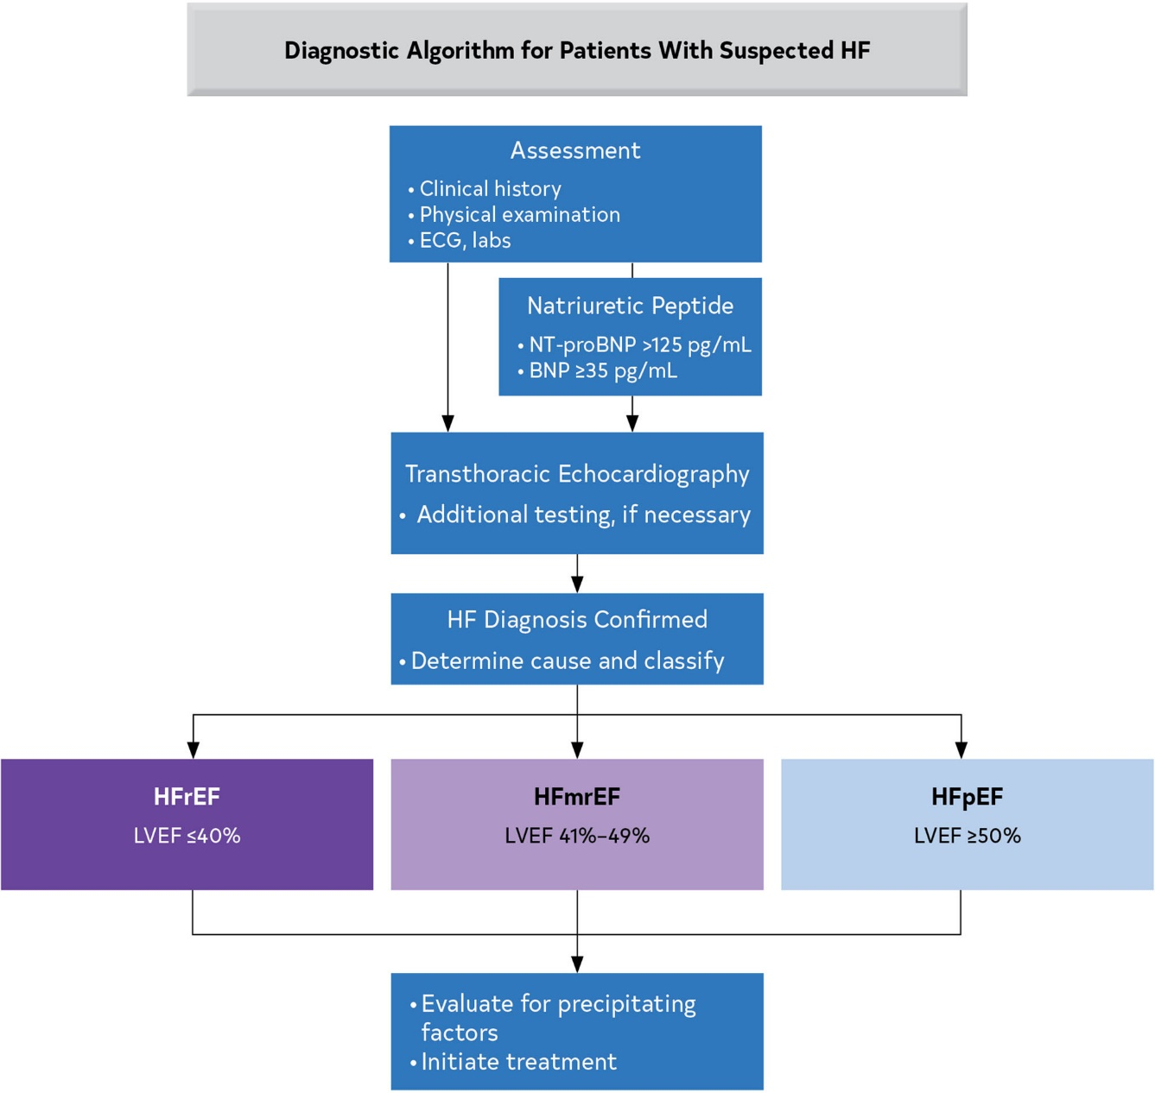
Diagnostic Algorithm for Classification of HF According to LVEF
HF: Heart Failure
EF: Ejection Fraction
HFrEF: HF with reduced EF
HFmrEF: HF with mildly reduced EF
HFpEF: HF with preserved EF
Ref: https://www.ahajournals.org/doi/10.1161/CIR.0000000000001063#d1e3118

Slide 6
Types of left-sided heart failure
There are two types of left-sided heart failure.
Drug treatments are different for the two types.
HFrEF (systolic failure): The heart can't pump with enough force to push enough blood into circulation.
HFpEF (diastolic failure): The heart can't properly fill with blood because the muscle has become stiff.
Ref: https://www.heart.org/en/health-topics/heart-failure/what-is-heart-failure/types-of-heart-failure

Slide 7
Diagnosis of HFpEF
Diagnosis of HFpEF is often challenging
A clinical composite score : H₂FPEF score (ranging from 0 to 9)
Obesity
Atrial fibrillation (AF)
Age >60 years
Treatment with ≥2 antihypertensive medications
Echocardiographic E/e’ ratio >9
Echocardiographic PA systolic pressure >35 mm Hg
Score | (0-2] | (2-6] | (6-9]
Likelihood of HFpEF | Low | May require further evaluation Hemodynamics with exercise echocardiogram Cardiac catheterization | High
Ref: https://www.ahajournals.org/doi/10.1161/CIRCULATIONAHA.118.035711

Slide 8
02
Tasks
Define problems and setup overall workflow

Slide 9
Cardiac Catheterization Image
Time series images
Need the existence of contrast to monitor cardiac cycle

Slide 10
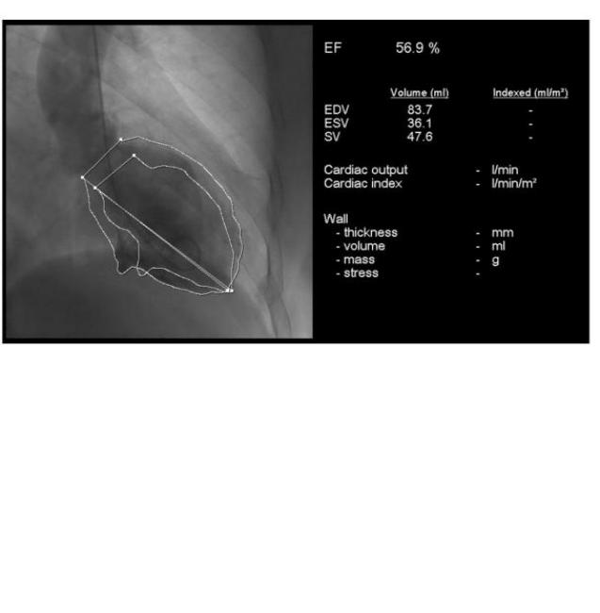
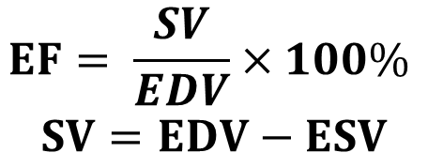
LVEF Calculation
$$EF= \frac{SV}{EDV}×100\%$$
$$SV=EDV−ESV$$
EF: Ejection Fraction
SV: Stroke Volume
EDV: End-diastolic Volume
ESV: End-systolic Volume

Slide 11
Overall workflow
1. Segmentation
Input a time series video
2. Calculate Volume
Based on the result of segmentation
3. Calculate LVEF
Time series data of calculated volume
Determine EDV, ESV
Detect for each frame

Slide 12
03
Methodology
Experiments and outcomes

Slide 13
STEP1
Image Segmentation

Slide 14
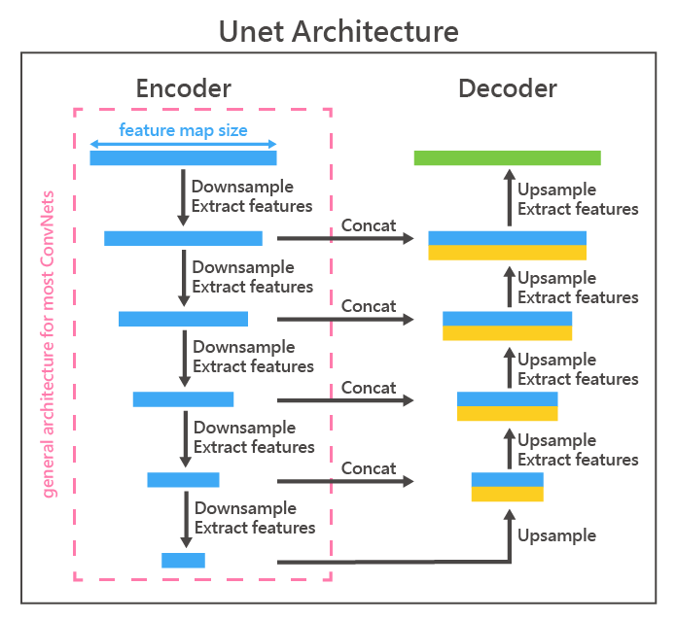
Image Segmentation Task
Unet model for the task
Try different but similar size CNN models for the encoder
ResNet-50 (baseline): 23M
EfficientNet-B4: 17M
DenseNet-201: 18M
Also try pretrained or non-pretrained weights for the 3 CNN models
Total 6 combinations
Conduct 10 experiments for each combination

Slide 15
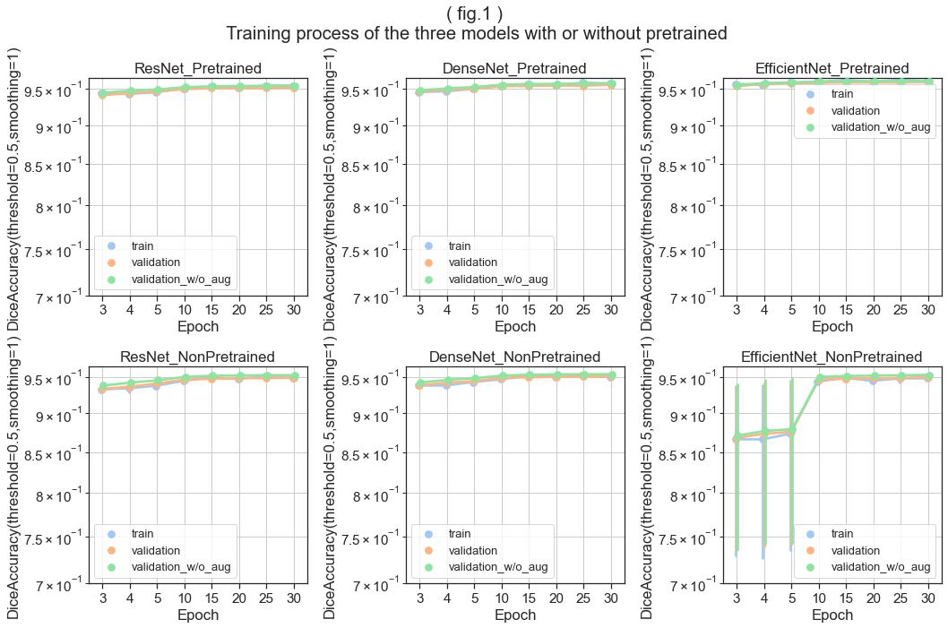
Segmentation Results – Training process
Validation w/o augmentation
Most model converge well after 3 epochs
Non-pretrained EfficientNet is not stable

Slide 16
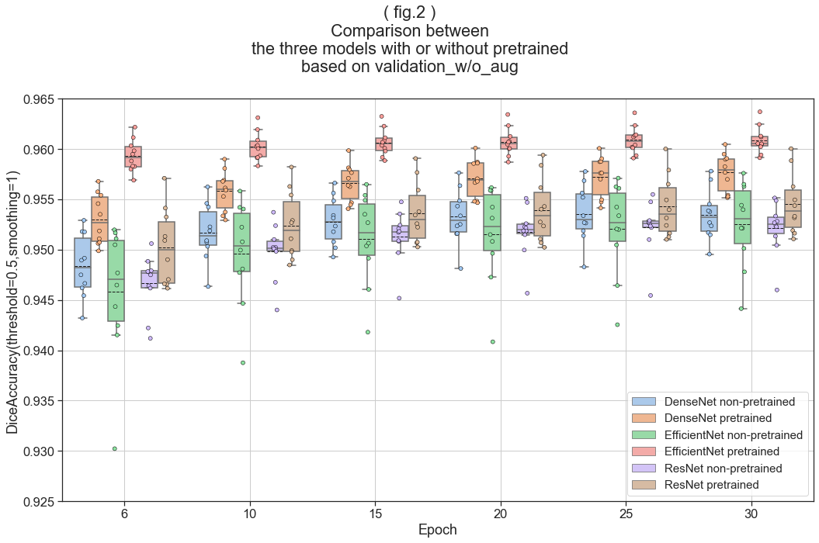
Segmentation Results – Training process
Pretrained EfficientNet is superior over the training process

Slide 17
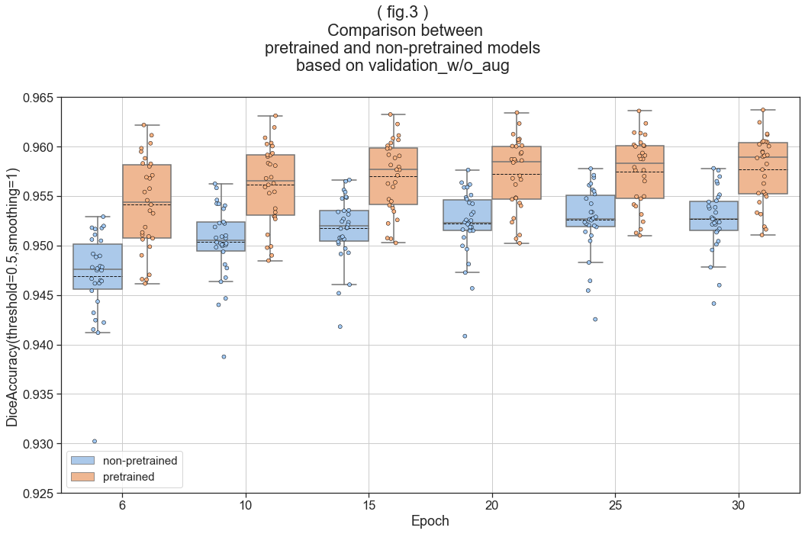
Segmentation Results – Training process
In all models, pretrain weights are better
Even the pretrained weights are based on ImageNet

Slide 18
Segmentation Results - Final
 |  | DenseNet-201 |  | EfficientNet-B4 |  | ResNet-50
 |  | Mean Dice Accuracy | Std Dice Accuracy | Mean Dice Accuracy | Std Dice Accuracy | Mean Dice Accuracy | Std Dice Accuracy
Non-pretrained | train | 0.950 | 0.0046 | 0.948 | 0.0020 | 0.948 | 0.0061
 | validation | 0.950 | 0.0027 | 0.950 | 0.0042 | 0.949 | 0.0031
 | validation_w/o_aug | 0.953 | 0.0025 | 0.953 | 0.0042 | 0.952 | 0.0026
pretrained | train | 0.958 | 0.0031 | 0.961 | 0.0022 | 0.954 | 0.0034
 | validation | 0.956 | 0.0021 | 0.960 | 0.0018 | 0.952 | 0.0034
 | validation_w/o_aug | 0.958 | 0.0019 | 0.961 | 0.0014 | 0.955 | 0.0030

Slide 19
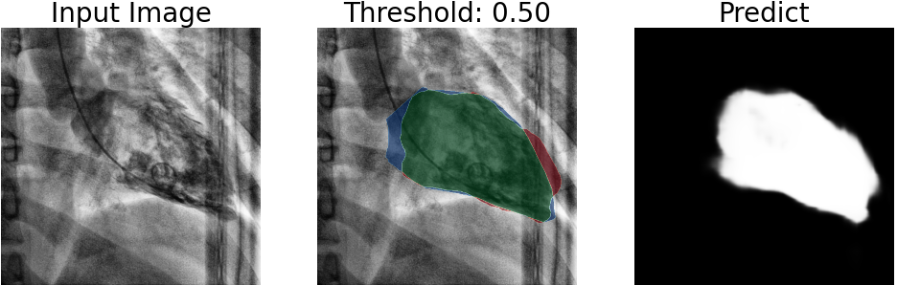
Segmentation Result - Visualize
Input image after preprocessing
Green: True Positive (TP)
Blue: False Negative (FN)
Red: False Positive (FP)
Gray scale mask prediction before threshold applied

Slide 20
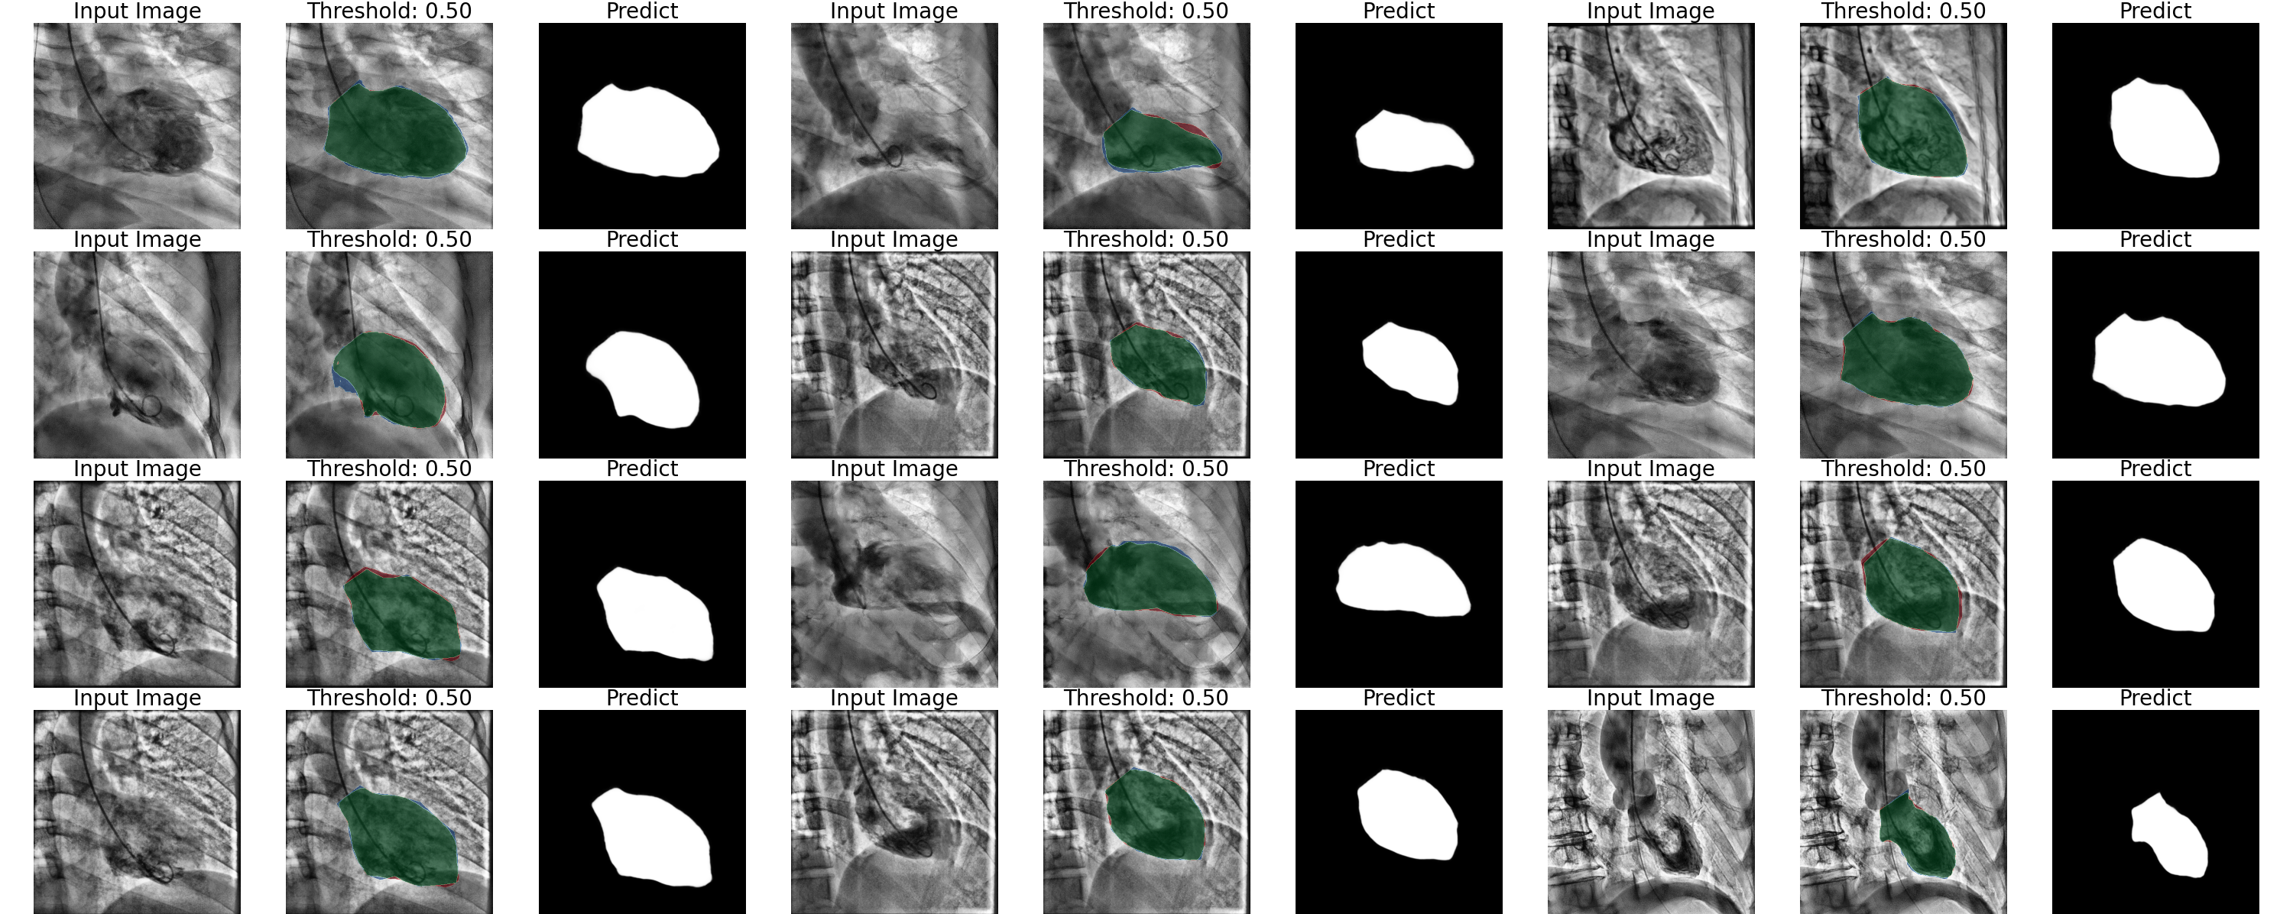
Segmentation Result - Visualize

Slide 21
STEP2
Volume Calculation

Slide 22
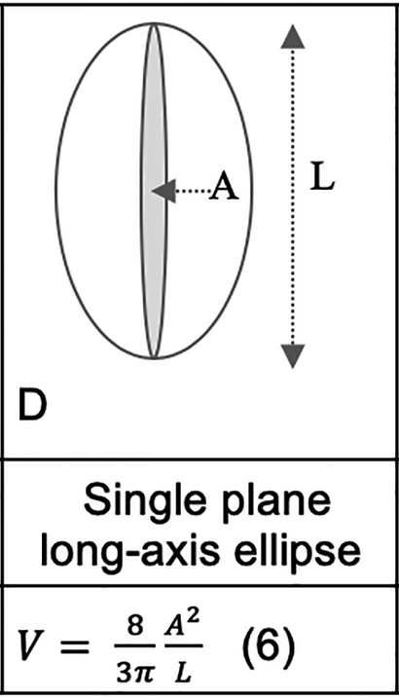
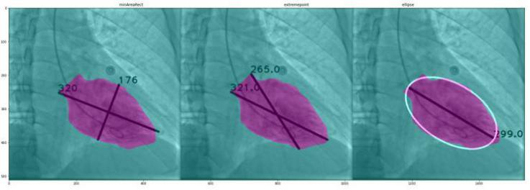
Volume Calculation
Journal of the American Heart Association (JAHA)
Accuracy of Left Ventricular Cavity Volume and Ejection Fraction for Conventional Estimation Methods and 3D Surface Fitting
MinAreaRec
ExtremePoint
Ellipse
Ref: https://www.ahajournals.org/doi/10.1161/JAHA.118.009124#d1e573

Slide 23
STEP3
DETERMINE CARDIAC CYCLE

Slide 24
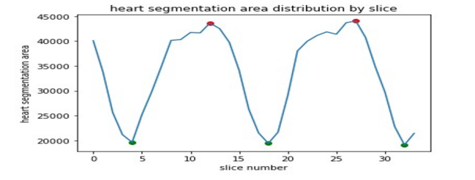
Volume Calculation
Time series data of the change of the estimated volume
Determine cardiac cycle
Determine ESV (green point), EDV (red point)

Slide 25
Volume Calculation - Result
 | MSE | RMSE | Relative Error
MinAreaRec | 0.0055 | 0.062 | 0.084
ExtremePoint | 0.0064 | 0.070 | 0.085
Ellipse | 0.0052 | 0.055 | 0.069
MinAreaRec
ExtremePoint
Ellipse

Slide 26
04
Conclusions
Future plans

Slide 27
Future plan
Unet and EfficientNet are relatively old, maybe try with some newer SOTA models might improve the accuracy.
The model should also predict the existence of contrast instead of only segmentation.
Develope an algorithm to recognize reasonable EDV, ESV from the time series of volume changes despite of some errors arise from the prediction error.

Slide 28
Thanks!
Do you have any questions?
E-mail: atlas0435@gmail.com
Mobile phone: 0981-224-068
GitHub: https://github.com/you-ming-hu

